Slide 1
Java - Files and I/O

Slide 2
Java – I/O File
The java.io package contains nearly every class you might ever need to perform input and output (I/O) in Java.
All these streams represent an input source and an output destination. The stream in the java.io package supports many data such as primitives, object, localized characters, etc.

Slide 3
Stream
A stream can be defined as a sequence of data. There are two kinds of Streams
InPutStream − The InputStream is used to read data from a source.
OutPutStream − The OutputStream is used for writing data to a destination.

Slide 4
Creating File in Java
File objFile = new File(File_Path);
The objFile.createNewFile() method is used to create a file in Java, and return a boolean value : true if the file is created successful; false if the file is already exists or the operation failed.

Slide 5
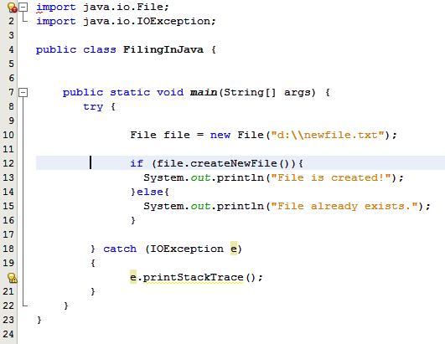
Creating File in Java

Slide 6
Reading and Writing Files
The InputStream is used to read data from a source and the OutputStream is used for writing data to a destination.
The hierarchy of classes to deal with Input and Output streams.

Slide 7
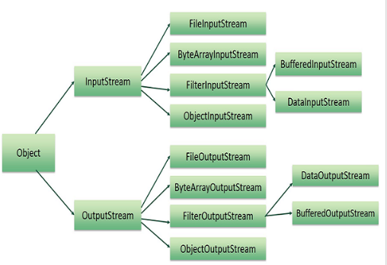
Reading and Writing Files
The two important streams are
FileInputStream and FileOutputStream

Slide 8
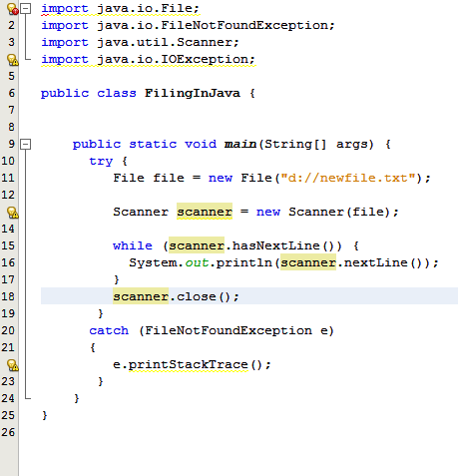
Reading a text file using Scanner class

Slide 9
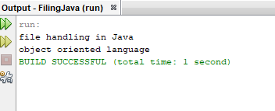
Reading a text file using Scanner class

Slide 10
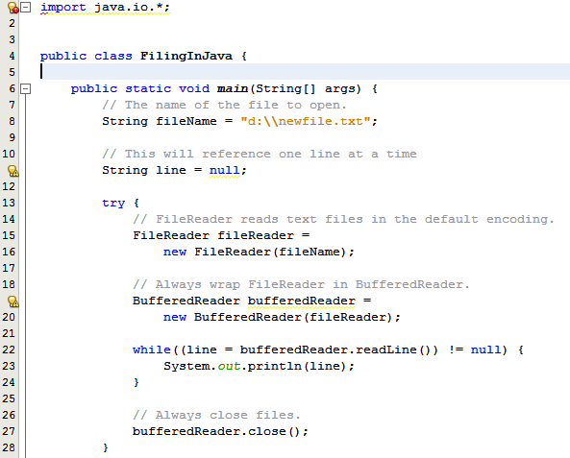
Reading a text file using File Reader

Slide 11
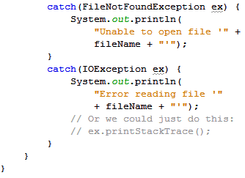
Reading a text file using File Reader

Slide 12
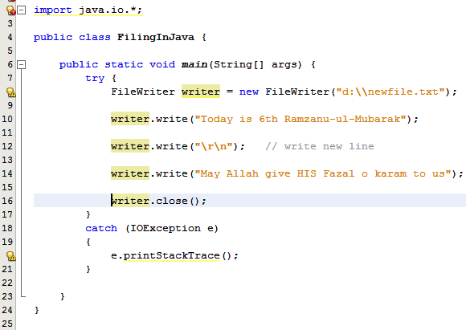

Writing to Text File Using FileWriter

Slide 13
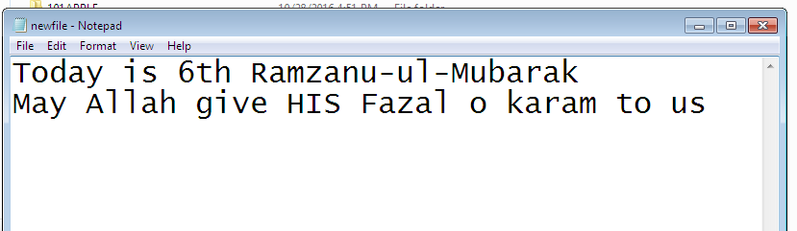
Writing to Text File Using FileWriter Output is

Slide 14
Writing to Text File Using FileWriter
A writer uses default character encoding of the operating system by default. It also creates a new file if not exits, or overwrites the existing one.
If you want to append text to an existing file, pass a boolean flag of true to constructor of the writer class: See example on next page

Slide 15
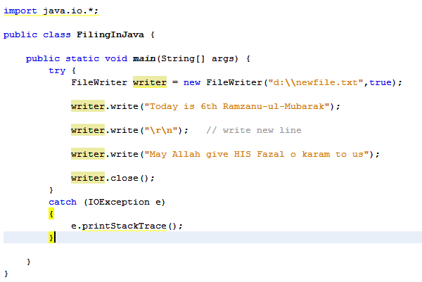
Writing to Text File Using FileWriter Appending Text to file

Slide 16
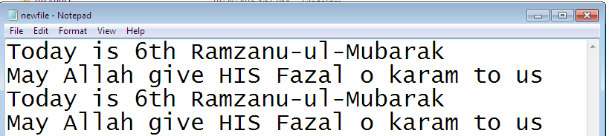
Writing to Text File Using FileWriter Output after Apending

Slide 17
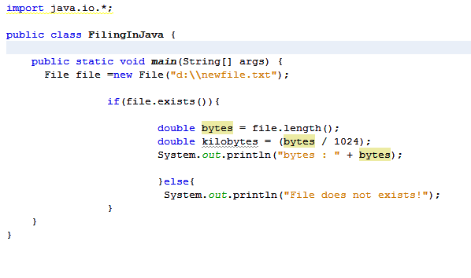
Finding File Size

Slide 18
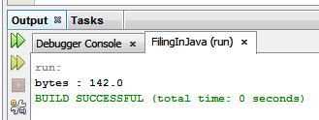
Finding File Size Output

Slide 19
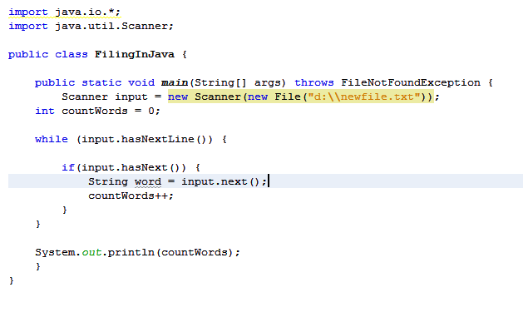
Counting words in file

